Slide 1
Word and Excel Basics

Slide 2
Important Aspects of Word Documentation
Font Size, Font Style, Font color
Margins
Layout
Generation of Table
Left and Right Intends
Justification of Text
Numering
Text Box
Review

Slide 3
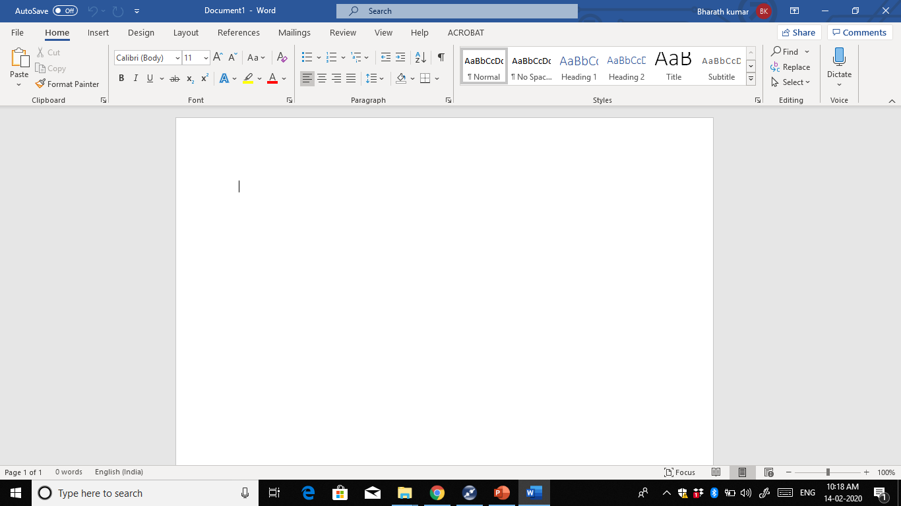
Font Size, Font Style, Font color
Choose font style
Choose font size
Choose font Colour

Slide 4
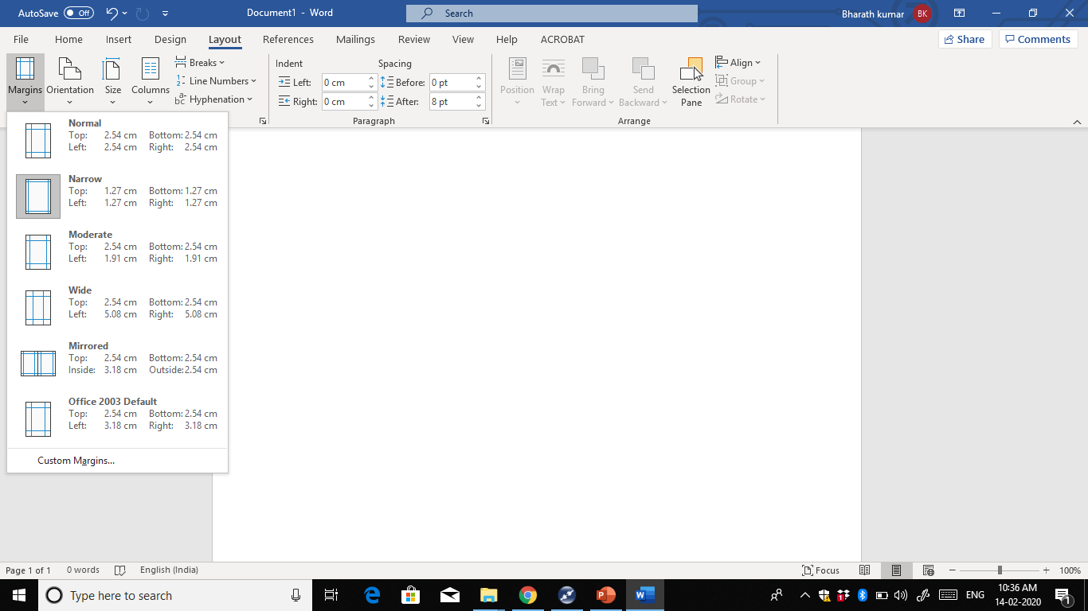
Margins
Click on the Layout then click on the margins and choose the Margin

Slide 5
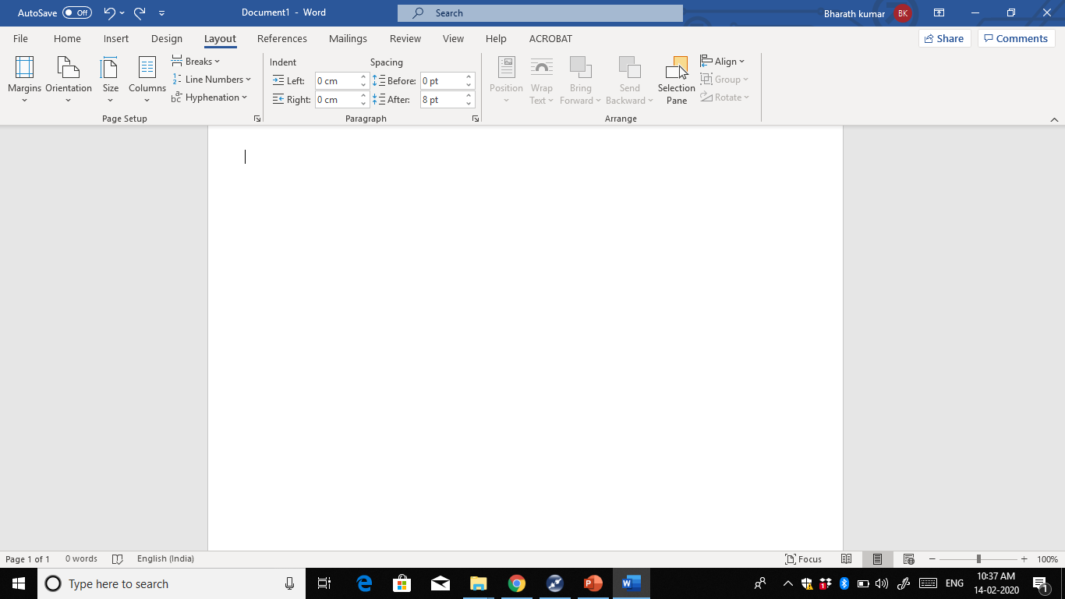
Layout
Can select different options related to page : Margins, Page Orientation, Page size, Columns,etc

Slide 6
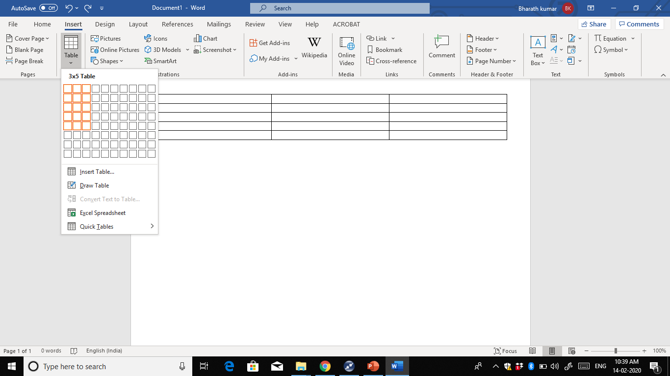
Generation of Table
Click on the Insert and Click on table and drag into the boxes

Slide 7
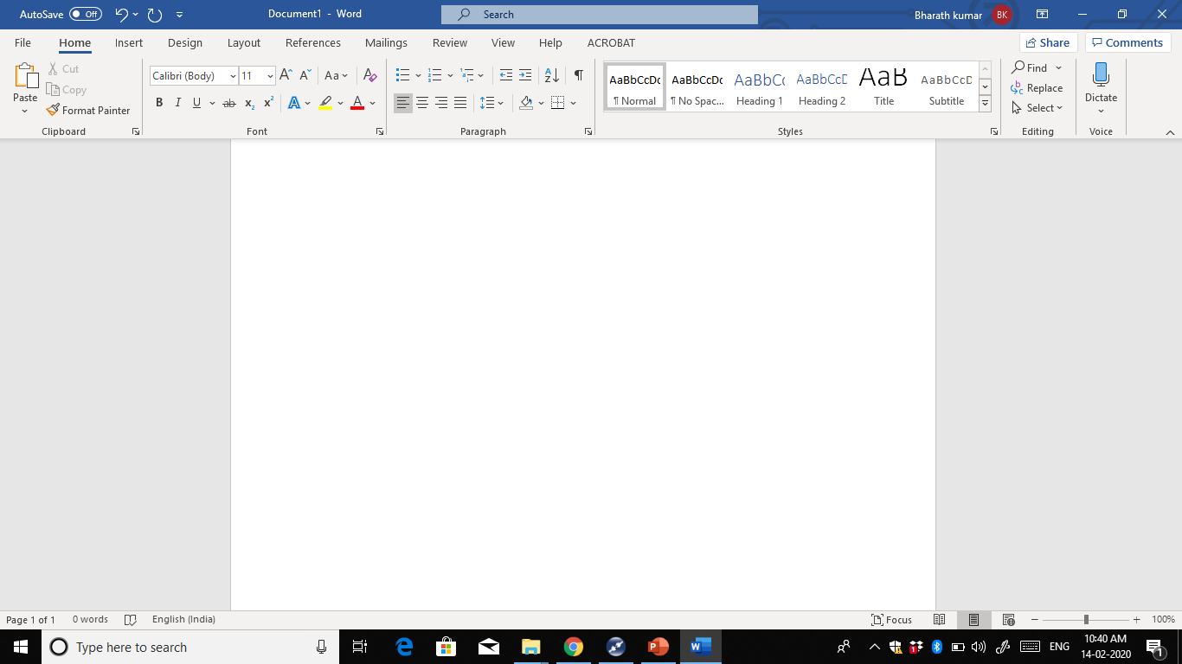
Left and Right Intends
Move the paragraph text closer to the Margin
Move the paragraph text farther Away from the Margin

Slide 8

Justification of Text
Distribute the text evenly between the margins

Slide 9
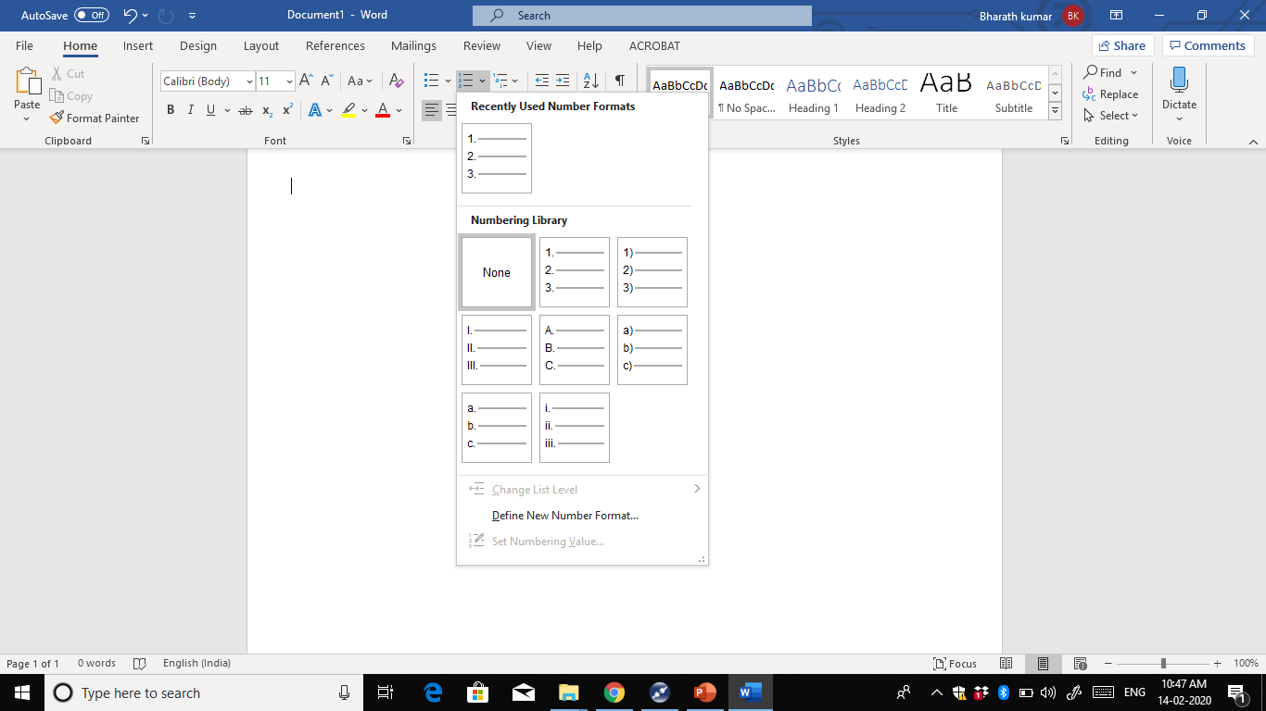
Numbering
Choose the numbering type

Slide 10
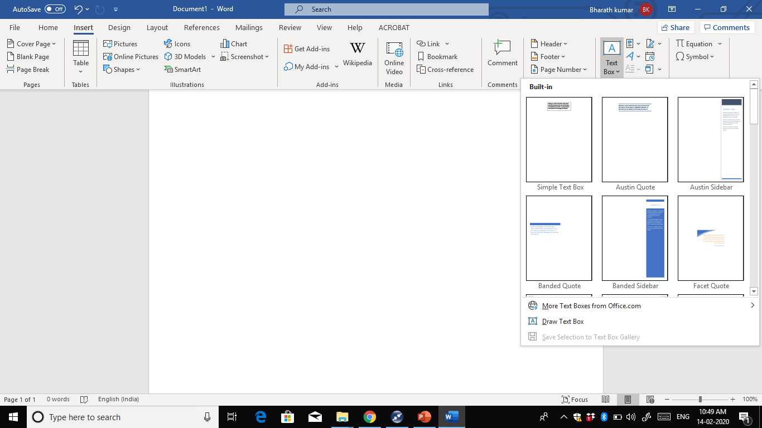
TextBox
Choose the textbox type

Slide 11
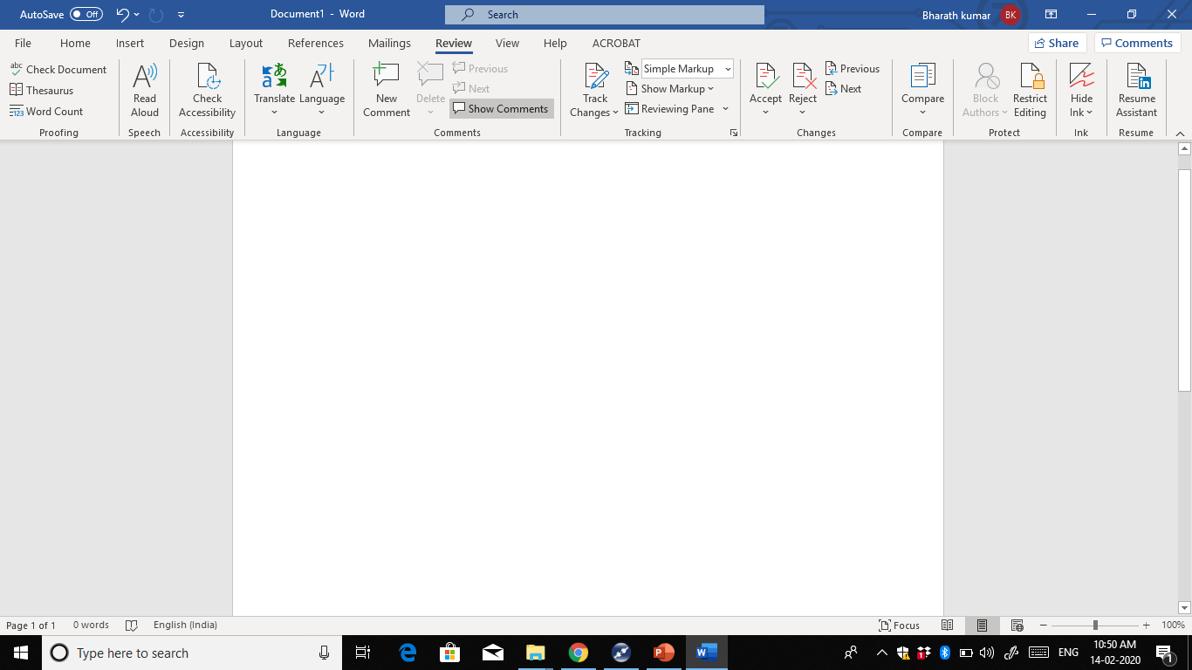
Review
Add the comments and show the comments while review the documet

Slide 12
Important Aspects of Excel Sheet
Spreadsheet and worksheet Terms
Basic Formulas – SUM, Difference, Multiply, Divide and Countif
Creation of Charts

Slide 13
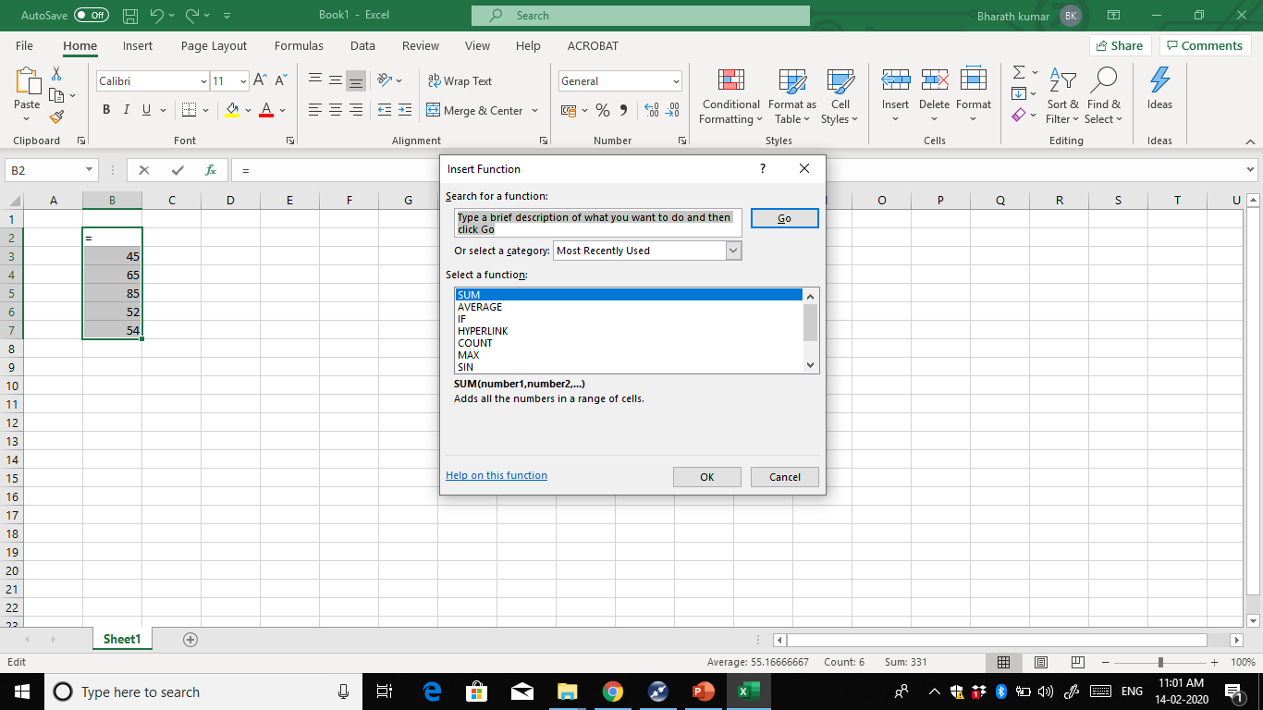
Basic Formulas – SUM, Difference, Multiply, Divide and Countif

Slide 14
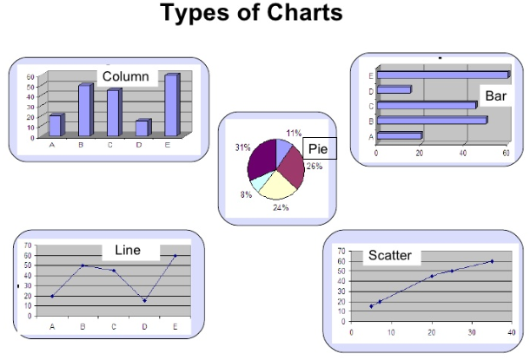
Types of Charts

Slide 15
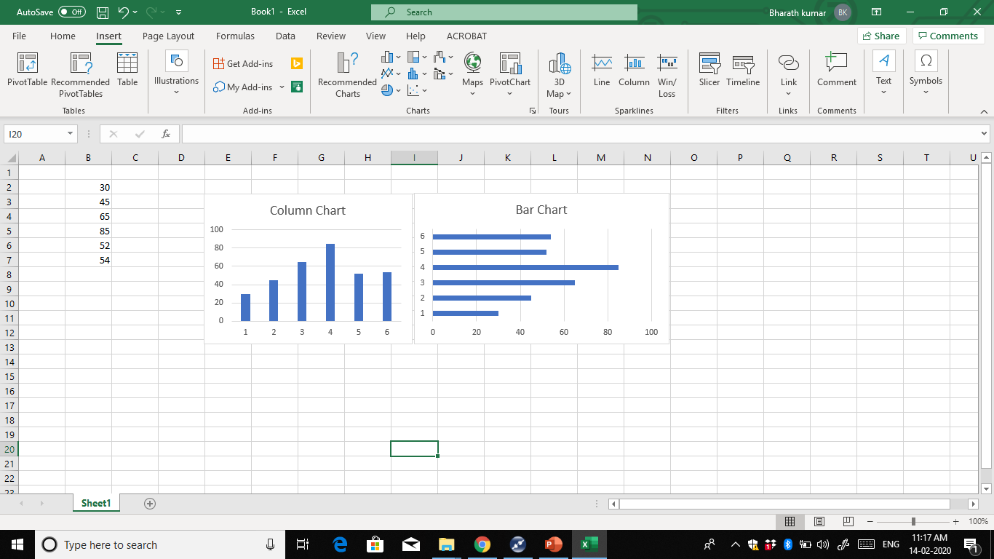
Column, Bar Chart
Click on Insert then Select the data and select the chart type
Values
y - axis
x -axis

Slide 16
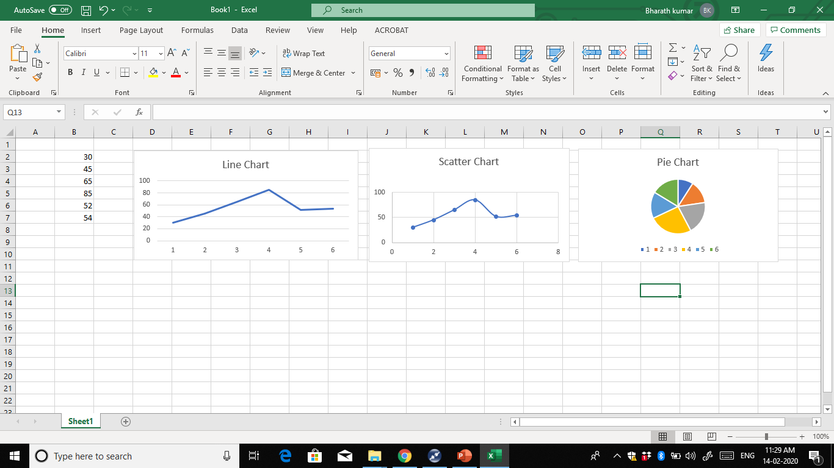
Line, Pie, Scatter chart
Y axis
X-axis
Categories

